Slide 1

Wine Quality Factors
Myranda Swartzwelter DSC-530

Slide 2
STUDENT- CENTERED PHILOSOPHY
Introduction and Hypothesis
As a wine lover, I can tell you about difference in grape varieties, New World vs Old World wines, and what a tannin is, but I don’t have much experience with the science behind what makes good wine. For centuries, farmers have been carefully cultivating their grapes to produce the best quality wine. I was able to find a data set that has 11 different qualities of the wine - from fixed and volatile acidity to alcohol content, and the scaled quality of the wine. As I did more digging into this subject, I found a paired datasets of the Portuguese Vinho Verde wine - one for the red variety of this wine and one for the white variety. I will combine these datasets for my analysis. This is a popular dataset, but the work is my own.
This analysis will use a regression model to answer the hypothesis:
Which of the variables are best correlated with wine quality? Does this differ between red and white wines?

Slide 3
Variables

Slide 4
Wine Data Set Input Variables
This data set has 12 input variables from physicochemical tests
Fixed Acidity
Volatile Acidity
Citric Acid
Residual Sugar
Chlorides
Free Sulfur Dioxides
Total Sulfur Dioxide
Density
pH Value
Sulphates
Alcohol Content
Red or White Wine

Slide 5
Wine Data Set Input Variables
Fixed Acidity
Volatile Acidity
Citric Acid
Unit: g/dm^3. Refers to the “fixed” acids in the wine, or acids that do not evaporate. Typically these are tartaric, malic, citric, and succinic acids.[1]]
Units: g/dm^3. Refers to the acids that undergo vaporization rapidly. Typically this is acetic acid in wine. [2]
Units: g/dm^3. Amount of citric acid - one of the key fixed acids.
Residual Sugars
Chlorides
Free Sulfur Dioxides
Unit: g/dm^3. The natural grape sugars left in the wine after fermentation is complete. [3]
Unit: g/dm^3. This is the amount of chlorides in the wine, which contribute to the saltiness of the wine
Unit: g/dm^3. The amount of SO2 that is present in the wine but has not yet reacted.This is critical for preserving wine. [4]

Slide 6
Wine Data Set Input Variables
Total Sulfur Dioxides
Density
pH Values
Unit: g/dm^3. Refers to the total SO2 concentration in the wine. [4]
Units: g/dm^3. Density of the wine.
pH is a measure of acidity of the wine.
Sulphates
Alcohol Content
Red or White Wine
Unit: g/dm^3. The potassium sulfates in wine. This helps with preservation. [4]
Percent of the wine that is alcohol.
Categorical variable to assign the wine based on the type of grape - red or white - that was used to make the wine.

Slide 7
Wine Data Set Dependent Variable
Quality: The quality in this data set is based on sensory data. It is the median value of at least 3 evaluations made by wine experts. Each expert graded the wine quality between 0 (very bad) and 10 (very excellent).

Slide 8
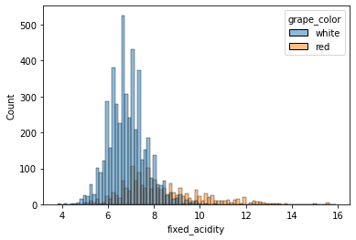
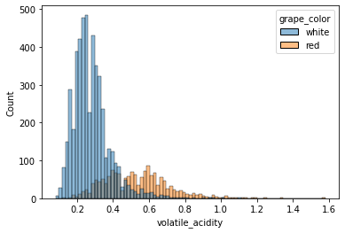
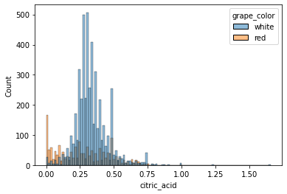
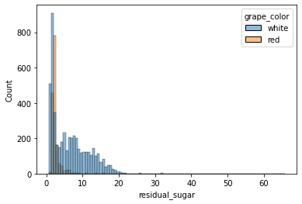
Histograms

Slide 9
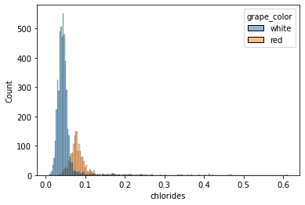
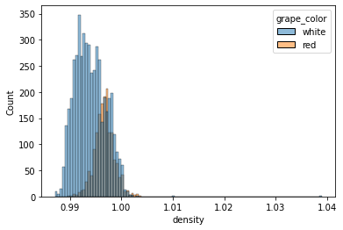
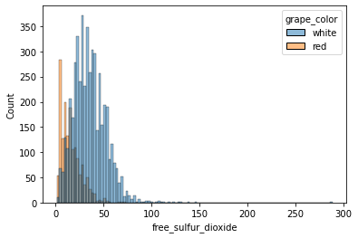
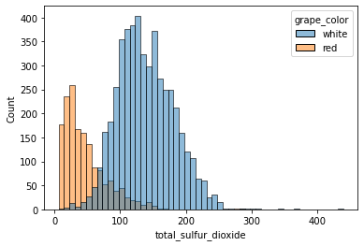
Histograms

Slide 10
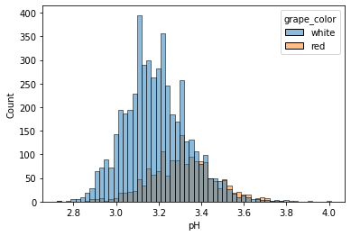
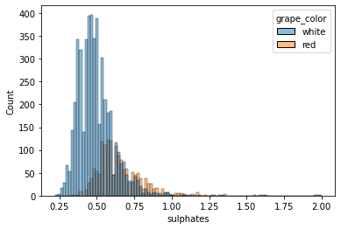
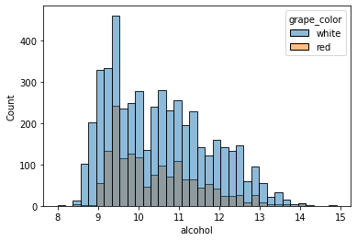
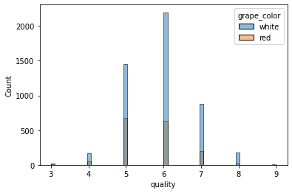
Histograms

Slide 11
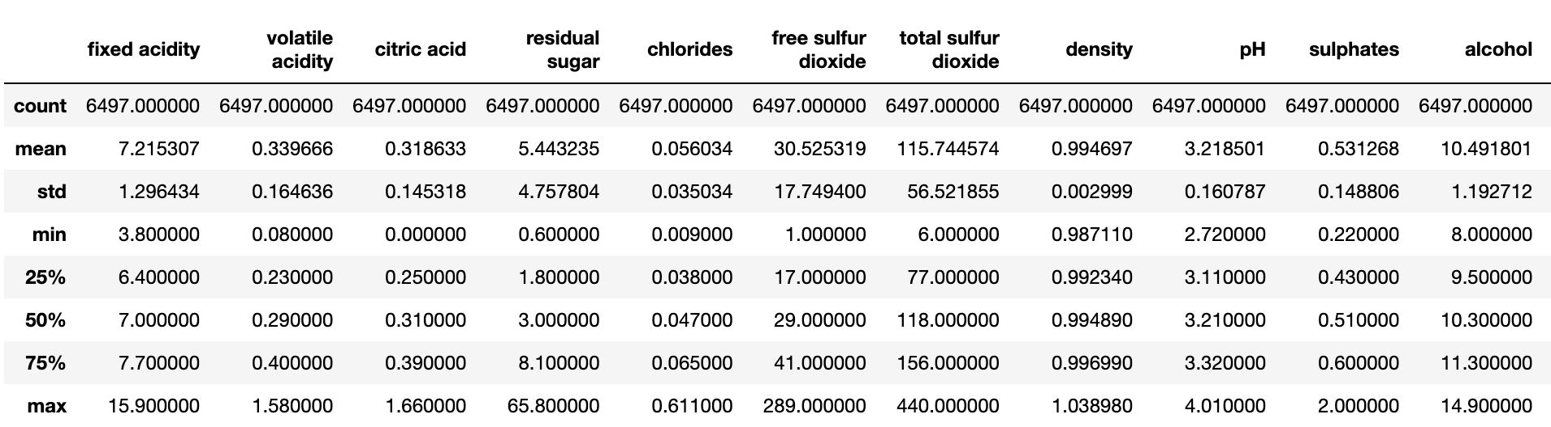
Summary Statistics for all variables

Slide 12
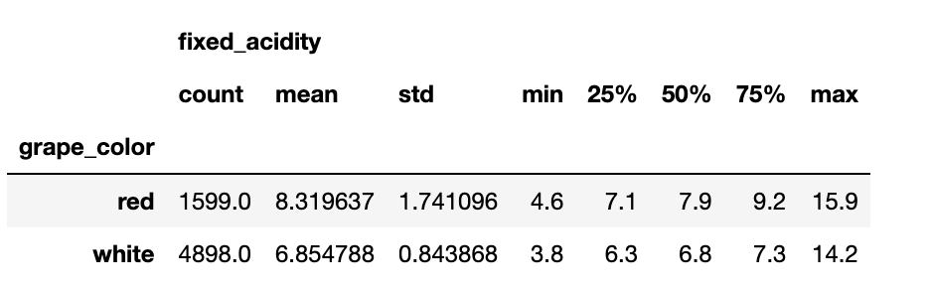
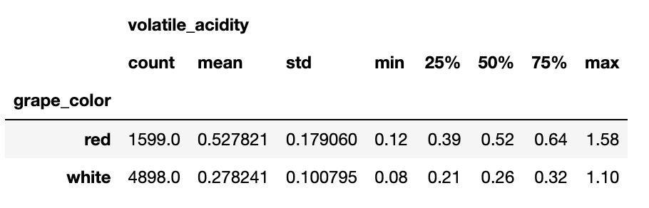
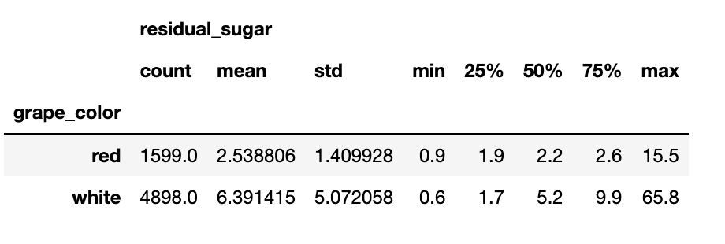
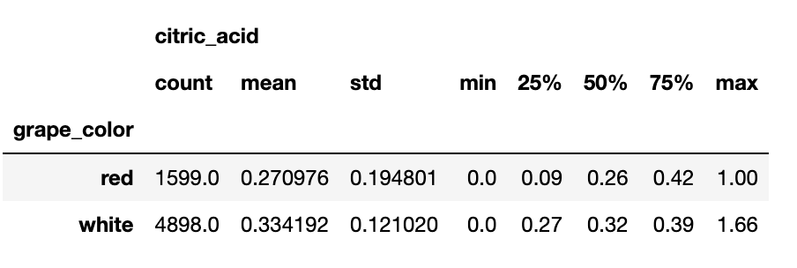
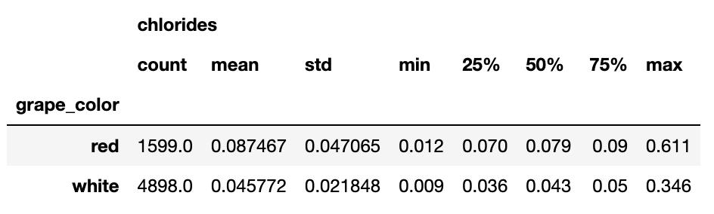
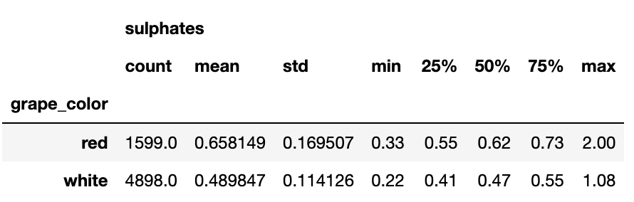
Summary Stats for each variable grouped by grape color

Slide 13
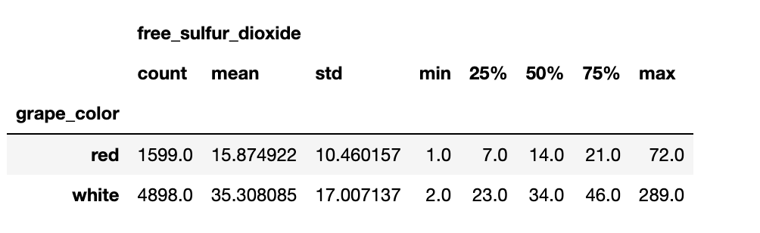
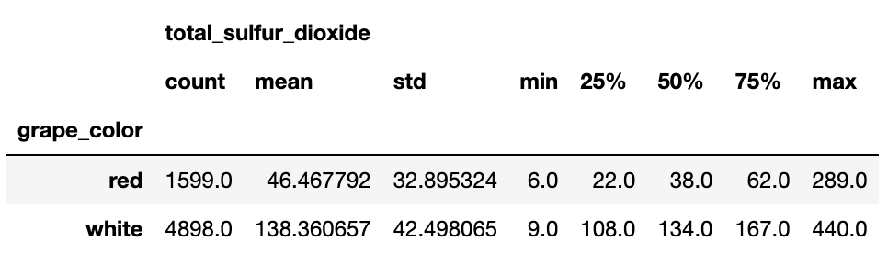
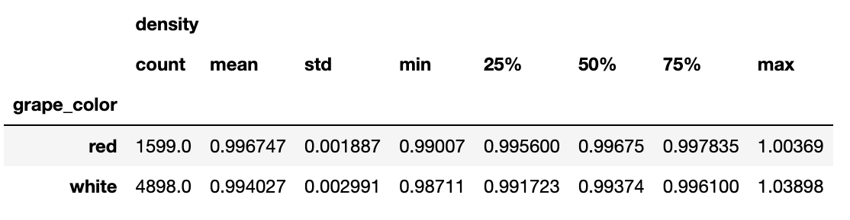
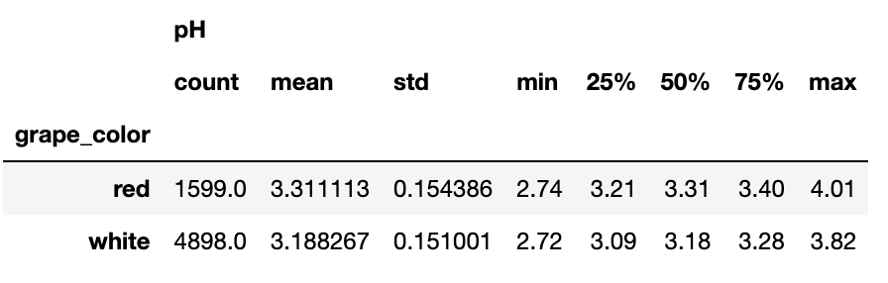
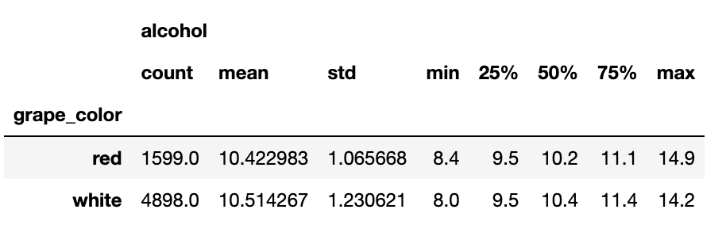
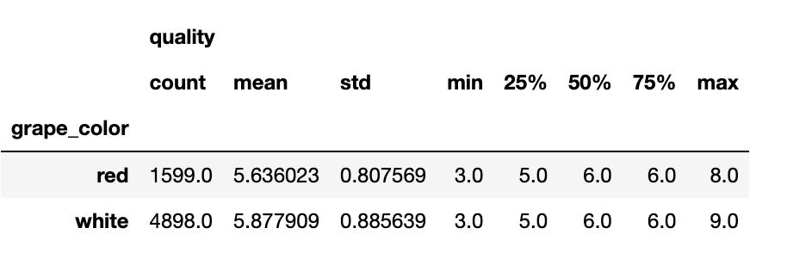
Summary Stats for each variable grouped by grape color

Slide 14
PMFs

Slide 15
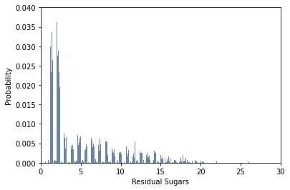
PMF of Residual Sugars
PMF of Residual Sugars variable for entire dataset. We can see the majority of measurements are below 10.

Slide 16
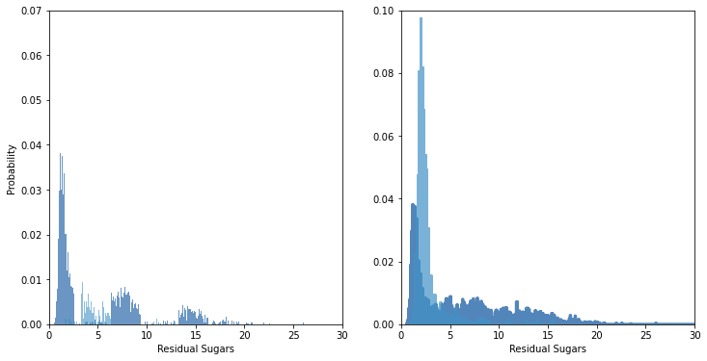
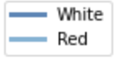
PMF of Residual Sugars broken out by grape color
We see a greater spread of probabilities for white wine than for red, which are concentrated at a lower sugar residual content.

Slide 17
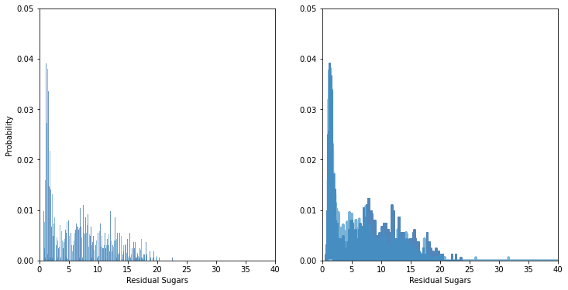
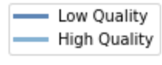
PMF of White Wine Residual Sugars broken out by quality
PMF for Sugar Residuals of white wines look similar for low and high quality wines.

Slide 18
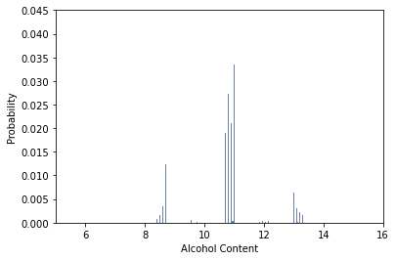
PMF of Alcohol Content
PMF of Alcohol Content variable for entire dataset. Almost looks normally distributed with some gaps.

Slide 19
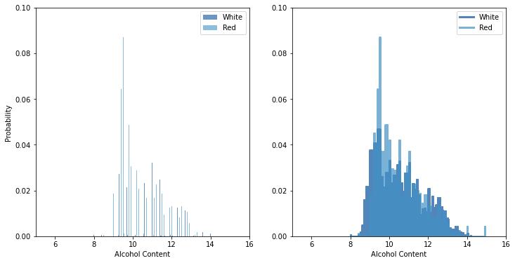
PMF of Alcohol Content broken out by grape color
The PMFs of Alcohol Content look similar for red and white wines, with spike in probabilities around 9%.

Slide 20
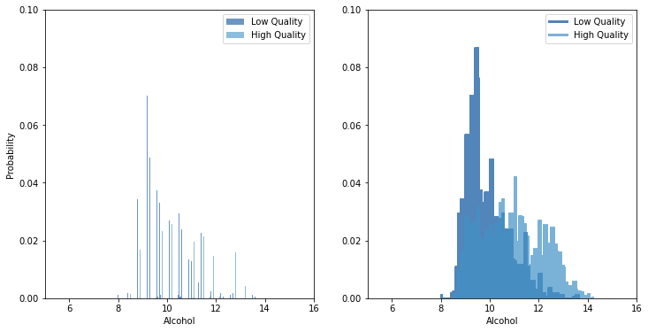
PMF of White Wine Alcohol Content broken out by quality
We can see that low quality wines tend to have a higher probability of a greater alcohol content than low quality wines.

Slide 21
CDFs

Slide 22
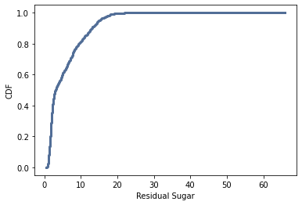
CDF of Residual Sugar Content
CDF of Residual Sugar content. This CDF shows high likelihood of a residual sugar content below 10.

Slide 23
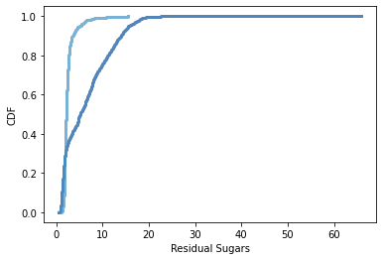
CDF of Residual Sugar Content by Grape Color
CDF of Residual Sugar content by grape color. The comparison shows red wines have a higher probability of less residual sugar than white wines.

Slide 24
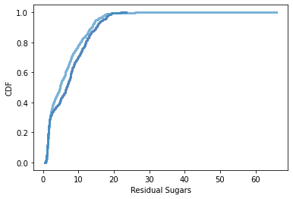
CDF of Residual Sugar Content by Wine Quality
CDF of Residual Sugar content by wine quality for white wines. This indicates that residual sugar may be similar between the two groups.

Slide 25
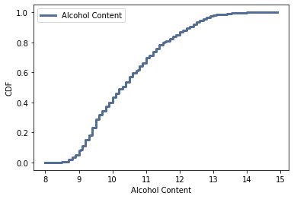
CDF of Alcohol Content
CDF of Alcohol Content. Comparing this CDF to the one of residual sugar, we see a less steep slope of likelihoods, so there is likely greater variety among the dataset.

Slide 26
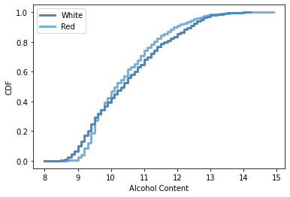
CDF of Alcohol Content by Grape Color
CDF of Alcohol content by grape color. The comparison shows red wines and white wines have similar alcohol contents.

Slide 27
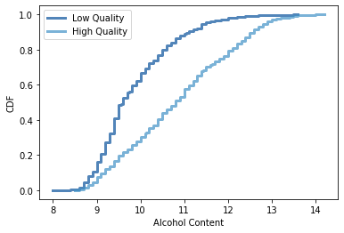
CDF of Alcohol Content by Wine Quality
CDF of Alcohol content by wine quality for white wines. This indicates that alcohol content may vary between the two groups.

Slide 28
Analytical Distribution

Slide 29
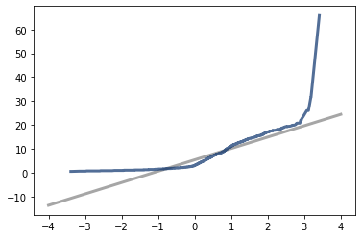
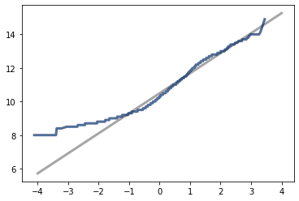
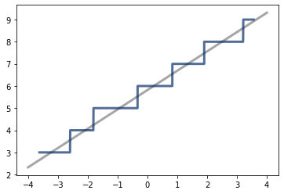
Normality Plots
Residual Sugar
Alcohol Content
Quality
These visualizations show normality plots for the residual sugar, alcohol content, and quality variables in the dataset. We use these plots to understand how well the normal distribution is good for the dataset. We see values in the tails of the residual sugar normality plot do not match the model well, so we would not use the normal distribution to model residual sugars. The left values of the alcohol content do not match the normality plot well, so if we were particularly interested in low-alcohol content wines, we would be advised to select another distribution. Quality is not a continuous variable, and we can see that in the step-wise values of this graph, although it seems to fit the model well.

Slide 30
Correlation and Causation

Slide 31
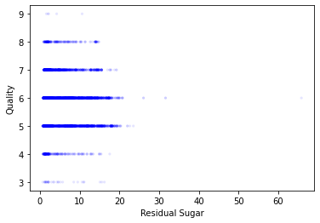
Scatter Plot of Residual Sugar and Quality
Since quality is a discrete variable, it is a little difficult to see due to overplotting, but there does not appear to be a relationship between residual sugar and quality beside potentially more residual sugar resulting in a medium-quality wine, but this may be an artifact of the variance between red and white wine.

Slide 32
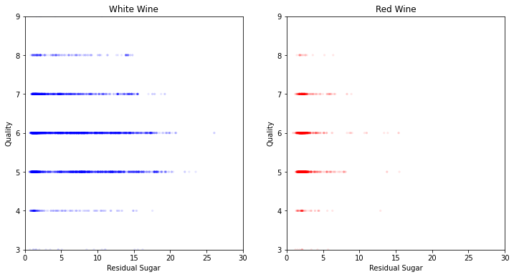
Scatter Plot of Residual Sugar and Quality by Grape Color
It’s important to know when comparing these scatter plots that there are more white wines than red wines in the data set, and the variability of residual sugar is higher in the white wine data set. Taking these considerations into account, it seems that the distribution is similar for Red and White wines.

Slide 33
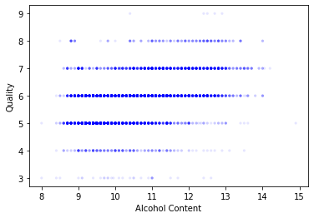
Scatter Plot of Alcohol Content and Quality
Again we see an overplotting problem due to the nature of plotting a discrete variable, but it seems that higher alcohol content could indicate a higher quality wine.

Slide 34
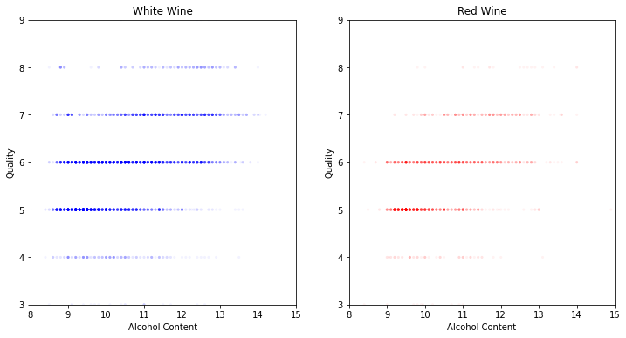
Scatter Plot of Residual Sugar and Quality by Grape Color
Here we can see that for both Red and White wines there appears to be a slight trend between higher alcohol content and higher quality wine.

Slide 35
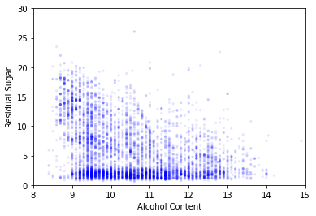
Scatter Plot of Alcohol Content and Residual Sugar
A scatter plot showing the relationship between Residual Sugar and Alcohol Content. Although both are input variables, it’s important to look at the

Slide 36
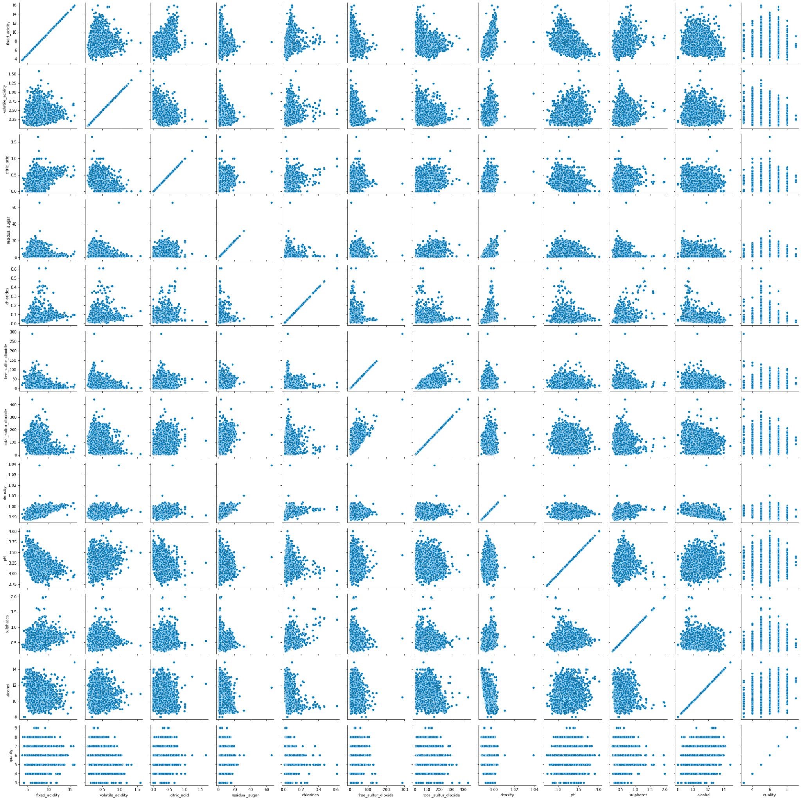
Scatter Plot of all variables
Although difficult to see in this presentation, this visualization is useful to quickly see which variables may be related to further investigate those relationships. In particular we can see from this that alcohol and quality may be related, while it appears that pH and quality may be independent.

Slide 37
Variable Covariances between the variable and Quality
Fixed Acidity Covariance -0.08686896468170188
Volatile Acidity Covariance -0.038193646354201104
Citric Acid Covariance 0.010852269368874835
Residual Sugar Covariance -0.15362202547681333
Chlorides Covariance -0.006138070355058322
Free Sulfur Dioxide Covariance 0.8595316093960229
Total Sulfur Dioxide Covariance -2.0423891312335134
Density Covariance -0.0008007983807020582
pH Covariance 0.0027383406068307893
Sulphates Covariance 0.005000241287764525
Alcohol Content Covariance 0.46270509169683777
These variables are not scaled to each other, so it’s difficult to understand how the covariances related to each other, however, it does appear there are some relationships between the variables. To understand this better we’ll look at the correlations as well.

Slide 38
Variable Correlations between the variable and Quality
Fixed Acidity Correlation -0.07674320790961987
Volatile Acidity Correlation -0.26569947761146784
Citric Acid Correlation 0.08553171718367845
Residual Sugar Correlation -0.03698048458576943
Chlorides Correlation -0.200665500435102
Free Sulfur Dioxide Correlation 0.05546305861663266
Total Sulfur Dioxide Correlation -0.041385453855608816
Density Correlation -0.3058579060694138
pH Correlation 0.019505703714435857
Sulphates Correlation 0.038485445876514444
Alcohol Content Correlation 0.4443185200075176
This analysis users Pearson’s correlation coefficient. Pearson's correlation is not robust in the presence of outliers, and it tends to underestimate the strength of non-linear relationships. Although there are no large outliers in this dataset, there may be non-linear relationships, especially as seen in the residual sugar scatter plot.
Correlation is a measure between -1 and 1. A value close to 0 indicates no correlation while a variable close to 1 or -1 indicates a relationship between the variables. This analysis indicates Volatile Acidity, Chlorides, Density and Alcohol Content may have the strongest relationship to quality.

Slide 39
Hypothesis Testing

Slide 40
Hypothesis Testing for Correlation
Based on the correlations just calculated, I’m now going to hypothesis test the for correlation. In this test we run 1000 trials to see if, under the null hypothesis, the correlation value that exceeds the observed correlation.
When I run the test for Alcohol and Quality I get a P Value of 0 which is statistically significant. The reported p-value is 0, which means that in 1000 trials we didn't see a correlation, under the null hypothesis, that exceeded the observed correlation. That means that the p-value is probably smaller than 1/1000, but it is not actually 0.
When I run the test for Residual Sugars and Quality, I get a P Value 0.04 which indicates that the test is statistically significant.
Running the test for correlations between pH and Quality, the P Value is 0.105. This indicates that we can not reject the null hypothesis.

Slide 41
Regression Analysis

Slide 42
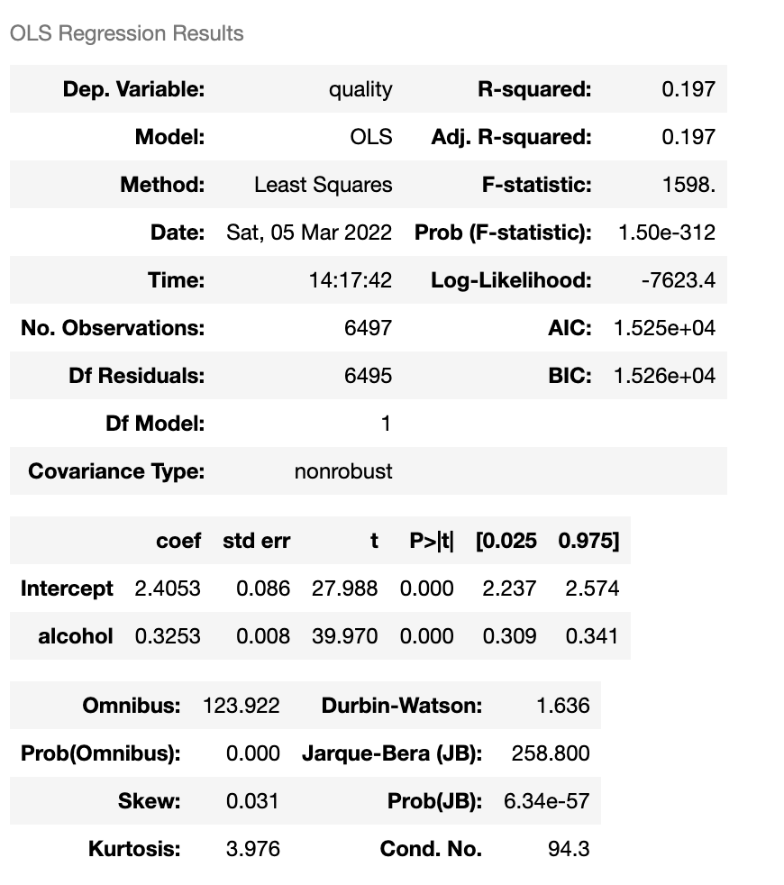
Regression Analysis
To begin, I did a regression analysis between the variables Quality and Alcohol since that had the highest correlation coefficient.
The p value indicates that alcohol content is a statistically significant variable in determining that alcohol content and Wine Quality are correlated. This is probably the best single-variable analysis, but since there are other correlated variables and the R-Squared value is low, a multivariate regression will be performed.

Slide 43
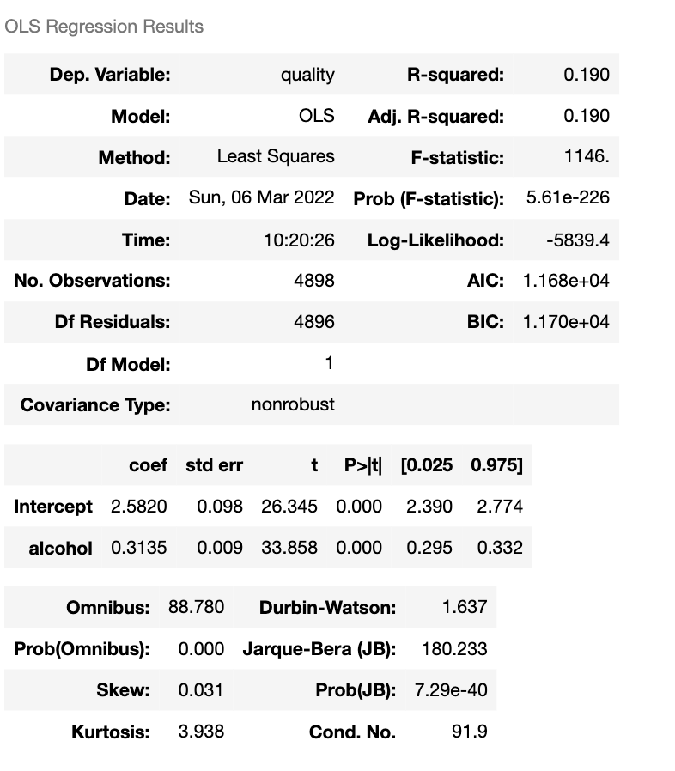

Final Regression Analysis - Single Variable
White Wine
Red Wine
Single regress for the split red and white wine data sets.

Slide 44

Regression Analysis
This is the regression analysis for the entire wine dataset and all variables. Here we see low P values for most variables, and while multiple things may be significant, likely there is multicollinearity causing this.

Slide 45


Regression Analysis
Doing a comparison of the Red wine and white wine regression analysis, we see that different variables are important. However, like with the full data set, we need to consider multicollinearity as well in our model.
White Wine Analysis
Red Wine Analysis

Slide 46

Multicollinearity
A quick look at the multicollinearity coefficients shows that several variables are related. This makes sense from a logical perspective, for example, total sulfur dioxide is the some of free sulfur dioxide and bonded sulfur dioxide, so if free sulfur dioxide is high, total sulfur dioxide will be high. We should account for this in our model by selecting the variables with high correlation, but leaving out the variables they have a high multicollinearity with.

Slide 47
Multicollinearity
A quick look at the multicollinearity coefficients shows that several variables are related. This makes sense from a logical perspective, for example, total sulfur dioxide is the some of free sulfur dioxide and bonded sulfur dioxide, so if free sulfur dioxide is high, total sulfur dioxide will be high. We should account for this in our model by selecting the variables with high correlation, but leaving out the variables they have a high multicollinearity with.

Slide 48


Final Correlations
White Wine
Red Wine
When looking at the correlations between variables and quality and adjusting for multicollinearity, we find that for white wines, the top 3 variables are alcohol, chlorides, and volatile acidity. For red wines, we find that the top 3 variables are alcohol, volatile acidity and sulphates, so we will run 2 more regression analyses with these variables.

Slide 49


Final Regression Analysis - Multivariate
White Wine
Red Wine
Although we see that the 3 variables selected all have low P values, the R-Squared statistic for these analyses are a little lower than when we include all variables. They are both still larger than when taking only the most correlated variable alone.

Slide 50
Sources

Slide 51
Sources
Data Set: P. Cortez, A. Cerdeira, F. Almeida, T. Matos and J. Reis.
Modeling wine preferences by data mining from physicochemical properties.
White, N. A. (2019, March 18). Fixed acidity. Waterhouse Lab. Retrieved March 1, 2022, from https://waterhouse.ucdavis.edu/whats-in-wine/fixed-acidity#:~:text=The%20predominant%20fixed%20acids%20found,2%2C000%20mg%2FL%20succinic%20acid.
White, N. A. (2019, March 18). Volatile acidity. Waterhouse Lab. Retrieved March 1, 2022, from https://waterhouse.ucdavis.edu/whats-in-wine/volatile-acidity#:~:text=Volatile%20acidity%20refers%20to%20the,chromatography%2C%20HPLC%20or%20enzymatic%20methods.
AboutMadeline PucketteJames Beard Award-winning author and Wine Communicator of the Year. I co-founded Wine Folly to help people learn about wine. @WineFolly. (2019, September 20). What is residual sugar in wine? Wine Folly. Retrieved March 1, 2022, from https://winefolly.com/deep-dive/what-is-residual-sugar-in-wine/
Salt in grapes and wine a common issue. (n.d.). Retrieved March 1, 2022, from https://www.awri.com.au/wp-content/uploads/2018/08/s1530.pdf

